Slide 1
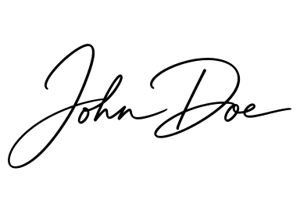
CERTIFICATE
of completion
This is to certify that
Jane Smith
Senior Analyst, Acme Training
has succesfully completed Advanced PowerPoint Automation
2026-08-10
Date
Signature

Slide 2
CERTIFICATE
of completion
This is to certify that
John Doe
Project Manager, Example Corp
has succesfully completed Presentation Mail Merge Basics
2026-07-11
Date
Signature

